Slide 1
Linear Regression
VENKATA VAMSI KRISHNA BHUVANAM – 3
VARUN CHAVAKULA – 4
SOWMYA YELIMATI – 32
VIKAS KONDAPALLI – 11

Slide 2
Regression
Technically: learning a function f(x)=y where y is real-valued, rather than discrete.
  Replace livesInSquirrelHill(x₁,x₂,…,x_{n}) with averageCommuteDistanceInMiles(x₁,x₂,…,x_{n})
  Replace userLikesMovie(u,m) with usersRatingForMovie(u,m)
  …

Slide 3
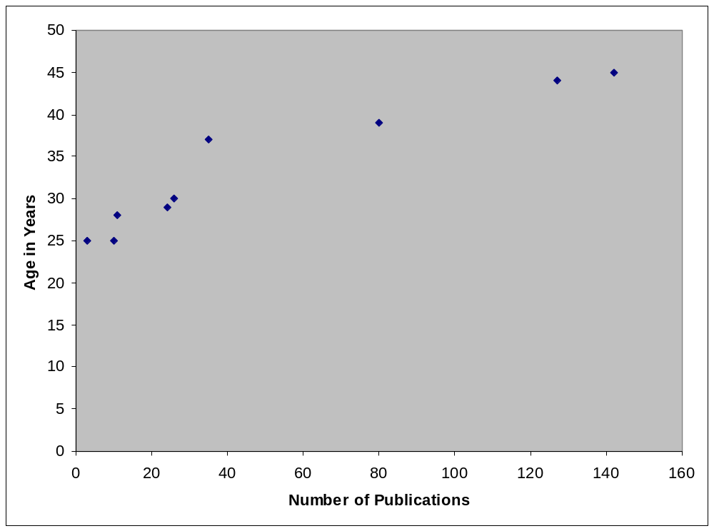
Example: univariate linear regression
Example: predict age from number of publications

Slide 4
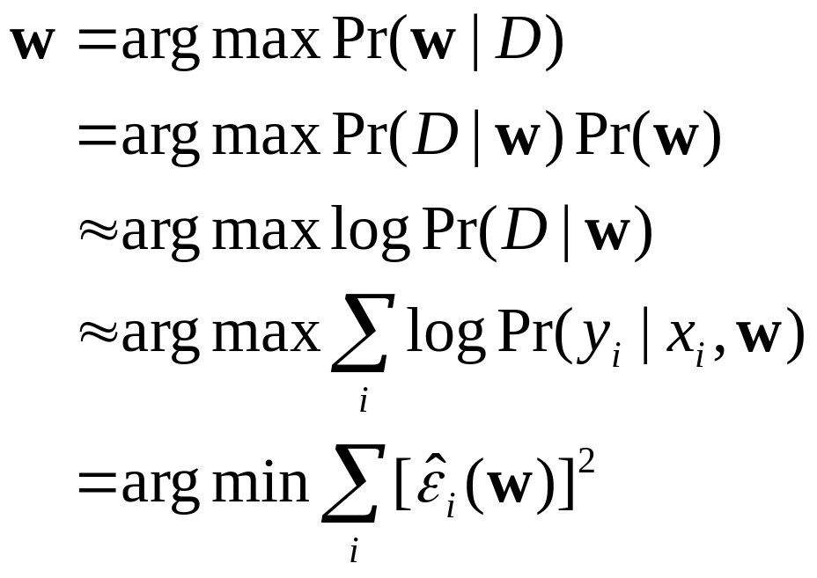
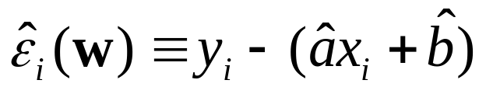
Linear regression
Model: y_{i} = ax_{i} + b + ε_{i} where ε_{i} ~ N(0,σ)
Training Data: (x₁,y₁),….(x_{n},y_{n})
Goal: estimate a,b with w=(a,b)
^
^

Slide 5
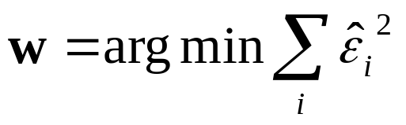
Linear regression
Model: y_{i} = ax_{i} + b + ε_{i} where ε_{i} ~ N(0,σ)
Training Data: (x₁,y₁),….(x_{n},y_{n})
Goal: estimate a,b with w=(a,b)
Ways to estimate parameters
  Find derivative wrt parameters a,b
  Set to zero and solve
    Or use gradient ascent to solve
    Or ….
^
^

Slide 6

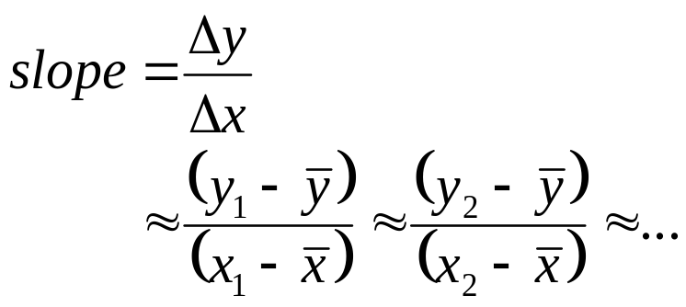

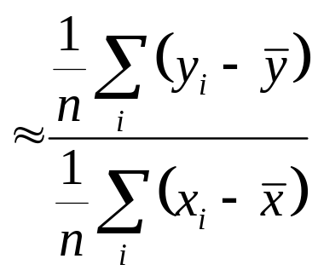
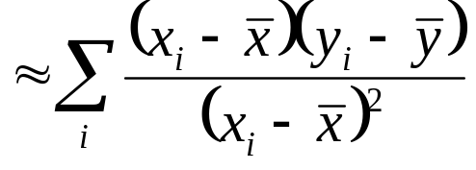
Linear regression
y₂
d₃
How to estimate the slope?
d₂
y₁
d₁
x₁
x₂
n*cov(X,Y)
n*var(X)

Slide 7
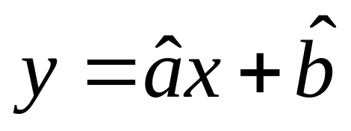
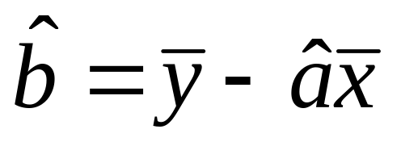
Linear regression
y₂
d₃
How to estimate the intercept?
d₂
y₁
d₁
x₁
x₂

Slide 8
Interpretation of Coefficients
1. Slope (β₁)
  Estimated Y Changes by β₁ for Each 1 Unit Increase in X
    If β₁ = 2, then Y Is Expected to Increase by 2 for Each 1 Unit Increase in X
^

Slide 9
Interpretation of Coefficients
1. Slope (β₁)
  Estimated Y Changes by β₁ for Each 1 Unit Increase in X
    If β₁ = 2, then Y Is Expected to Increase by 2 for Each 1 Unit Increase in X
2. Y-Intercept (β₀)
  Average Value of Y When X = 0
    If β₀ = 4, then Average Y Is Expected to Be 4 When X Is 0
^
^

Slide 10
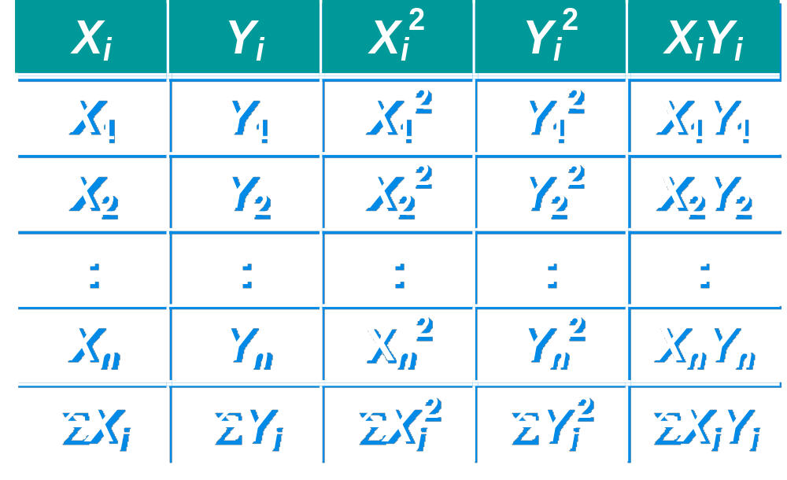
Computation Table

Slide 11

Example 1:
You’re a Vet epidemiologist for the county cooperative. You gather the following data:
Food (lb.) Milk yield (lb.)
4 3.0
6 5.5
10 6.5
12 9.0
What is the relationship
between cows’ food intake and milk yield?
© 1984-1994 T/Maker Co.

Slide 12

Scatter Plot Diagram
Milk Yield vs. Food Intake
M. Yield (lb.)
Food intake (lb.)

Slide 13
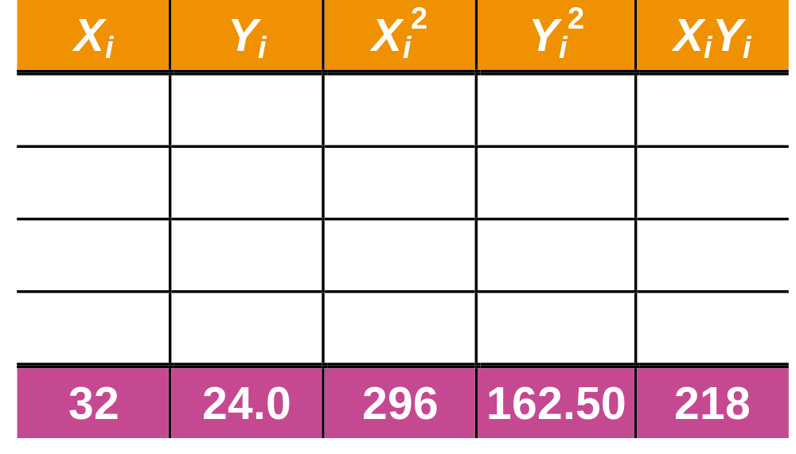
Computation Table for Example:

Slide 14
Parameter Estimation

Slide 15
Coefficient Interpretation
^
1. Slope (β₁)
  Milk Yield (Y) Is Expected to Increase by .65 lb. for Each 1 lb. Increase in Food intake (X)

Slide 16
Coefficient Interpretation
^
1. Slope (β₁)
  Milk Yield (Y) Is Expected to Increase by .65 lb. for Each 1 lb. Increase in Food intake (X)
2. Y-Intercept (β₀)
  Average Milk yield (Y) Is Expected to Be 0.8 lb. When Food intake (X) Is 0
^

Slide 17
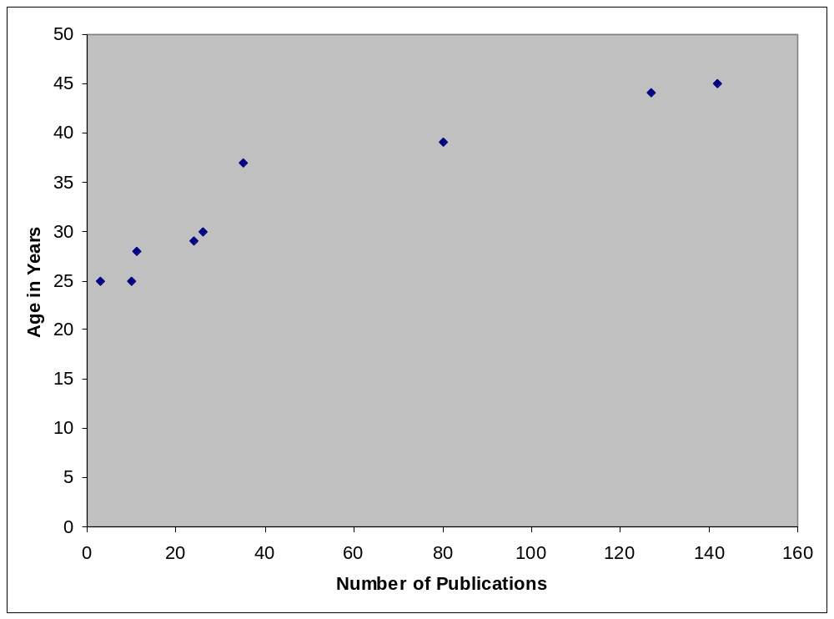
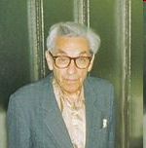
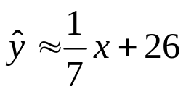
Example: univariate linear regression
Paul Erdős
Example: predict age from number of publications
Hungarian mathematician, 1913-1996
x ~ 1500
age about 240

Slide 18
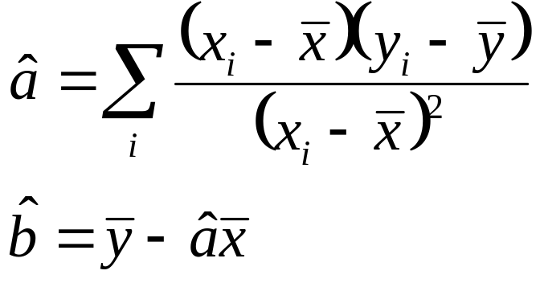
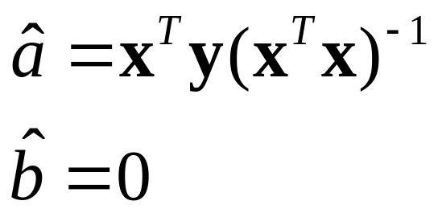
Linear regression
Summary:
y₂
d₃
d₂
y₁
d₁
To simplify:
assume zero-centered data, as we did for PCA
let x=(x₁,…,x_{n}) and y =(y₁,…,y_{n})
then…
x₁
x₂

Slide 19
References
Carnegie Mellon University - http://www.cs.cmu.edu/~tom/10601_sp08/slides/regression-april-14.ppt
Michigan State University - https://www.msu.edu/~fuw/teaching/Fu_Ch11_linear_regression.ppt

